Slide 1
Deep Learning for your Hackathon Project
Mary Wahl
7/14/17

Slide 2
General outline for this talk
One hour to prepare someone to use neural networks on a project
Focus on implementation, not theory
Show how to leverage existing code
Two examples:
Transfer learning for image classification
Reinforcement learning for playing “Hangman”

Slide 3
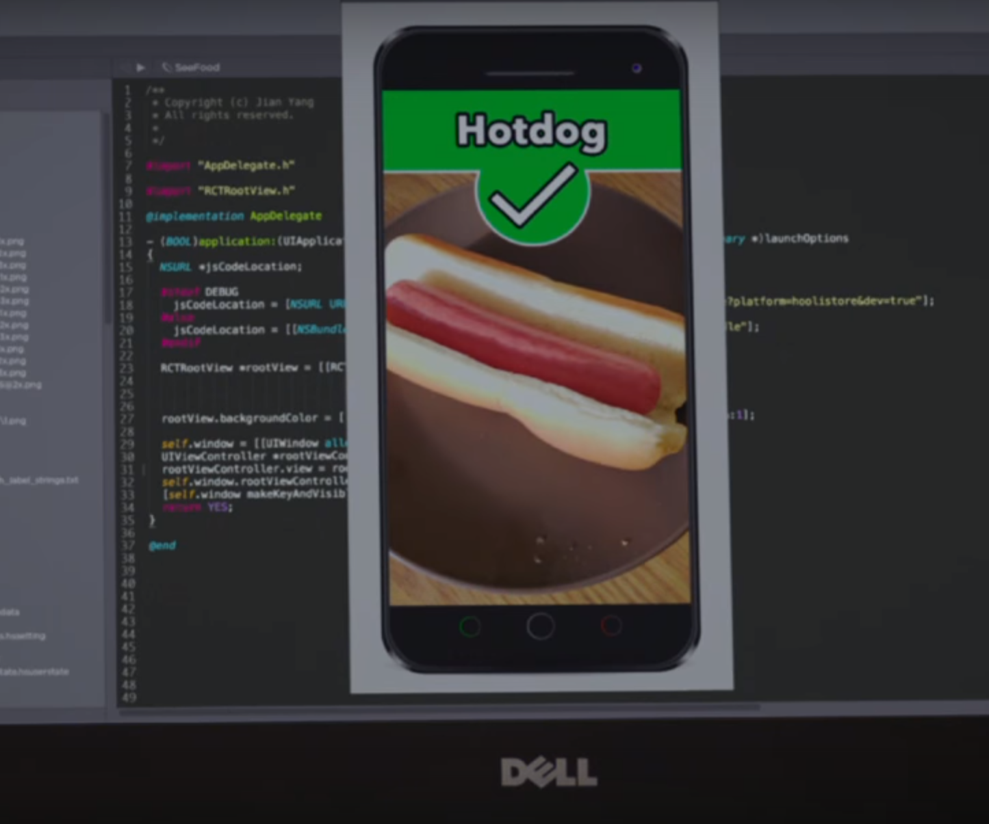
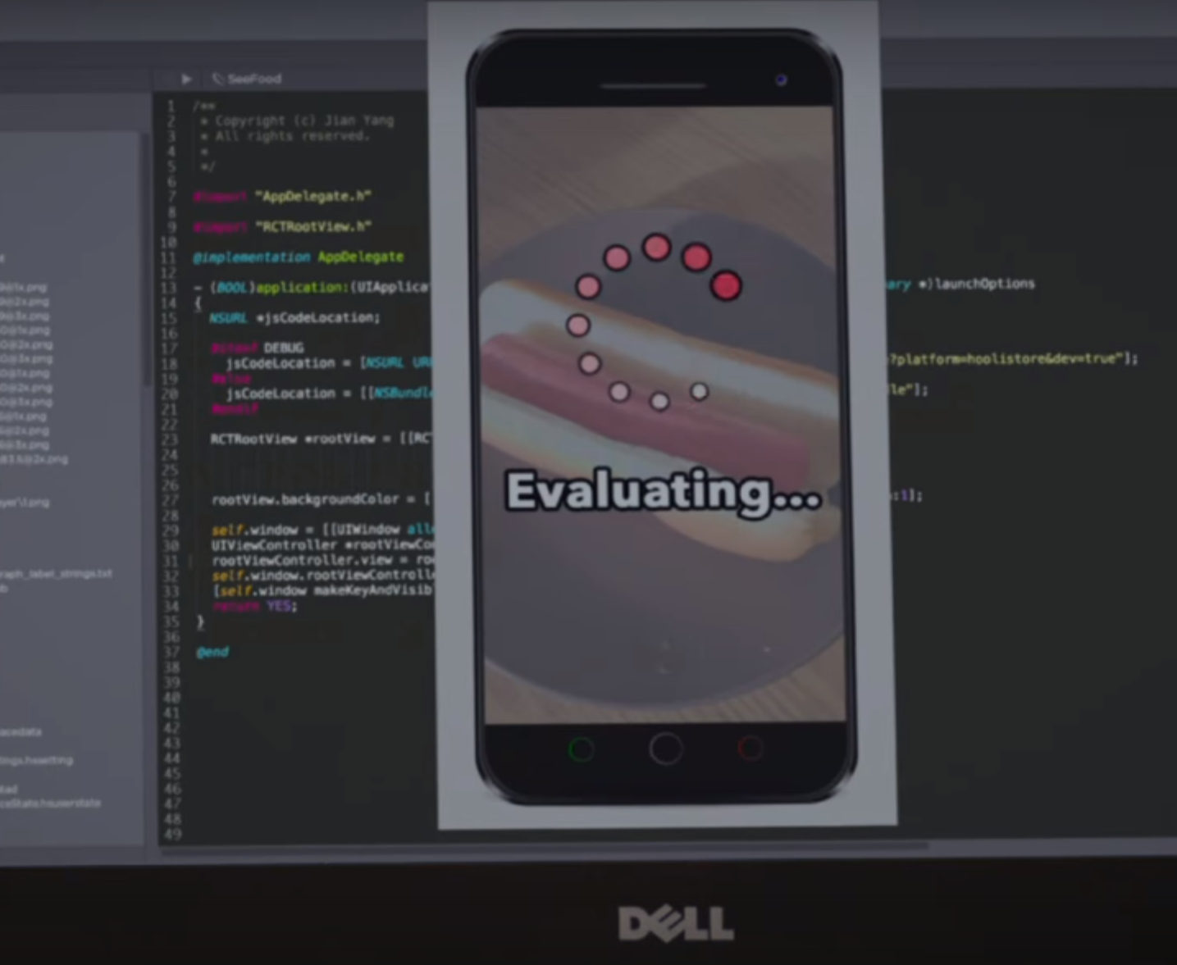
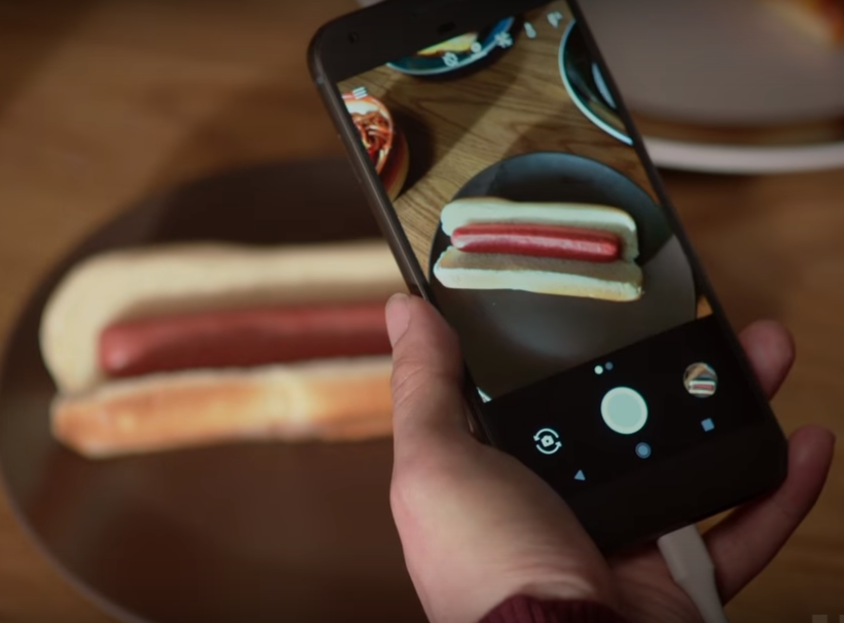
Stereotypical use case for image classification

Slide 4
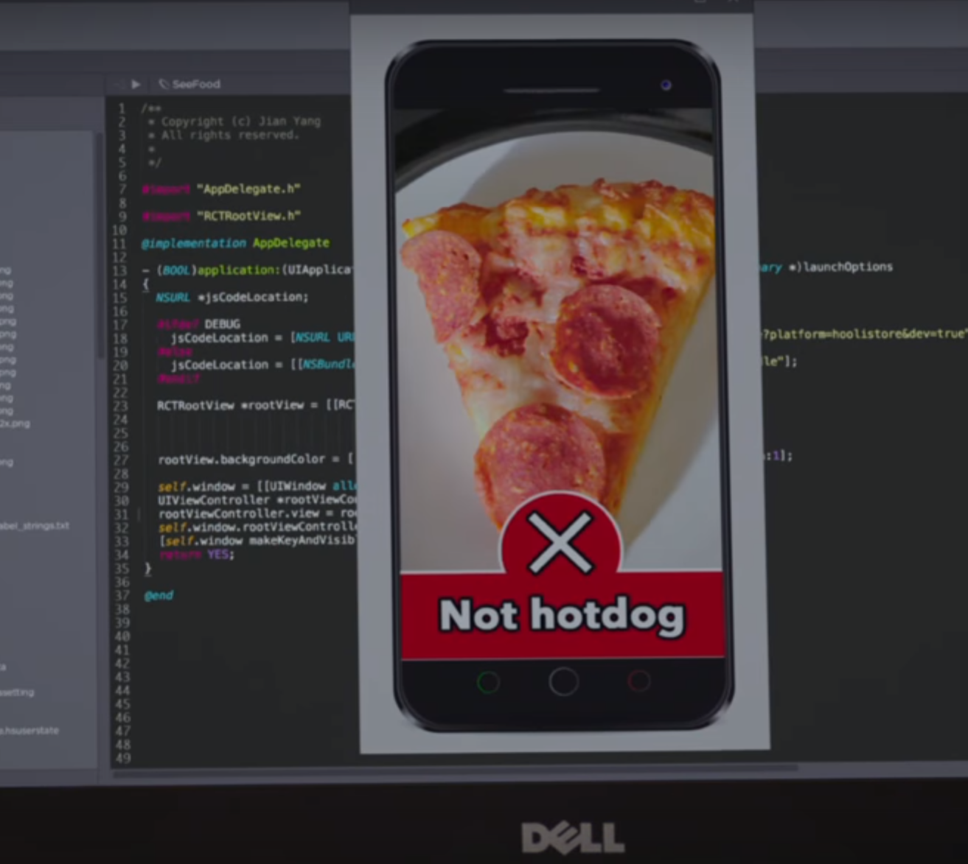
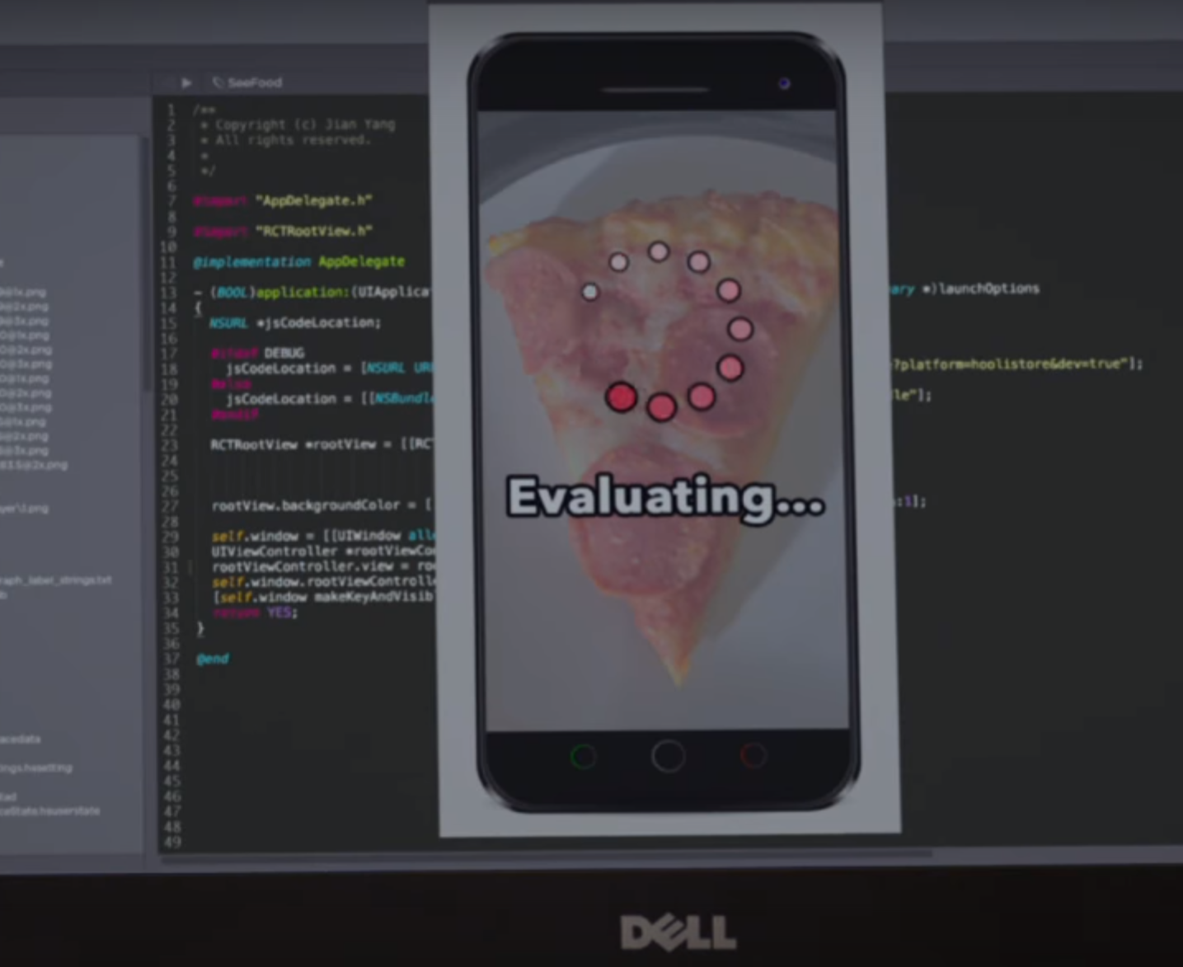
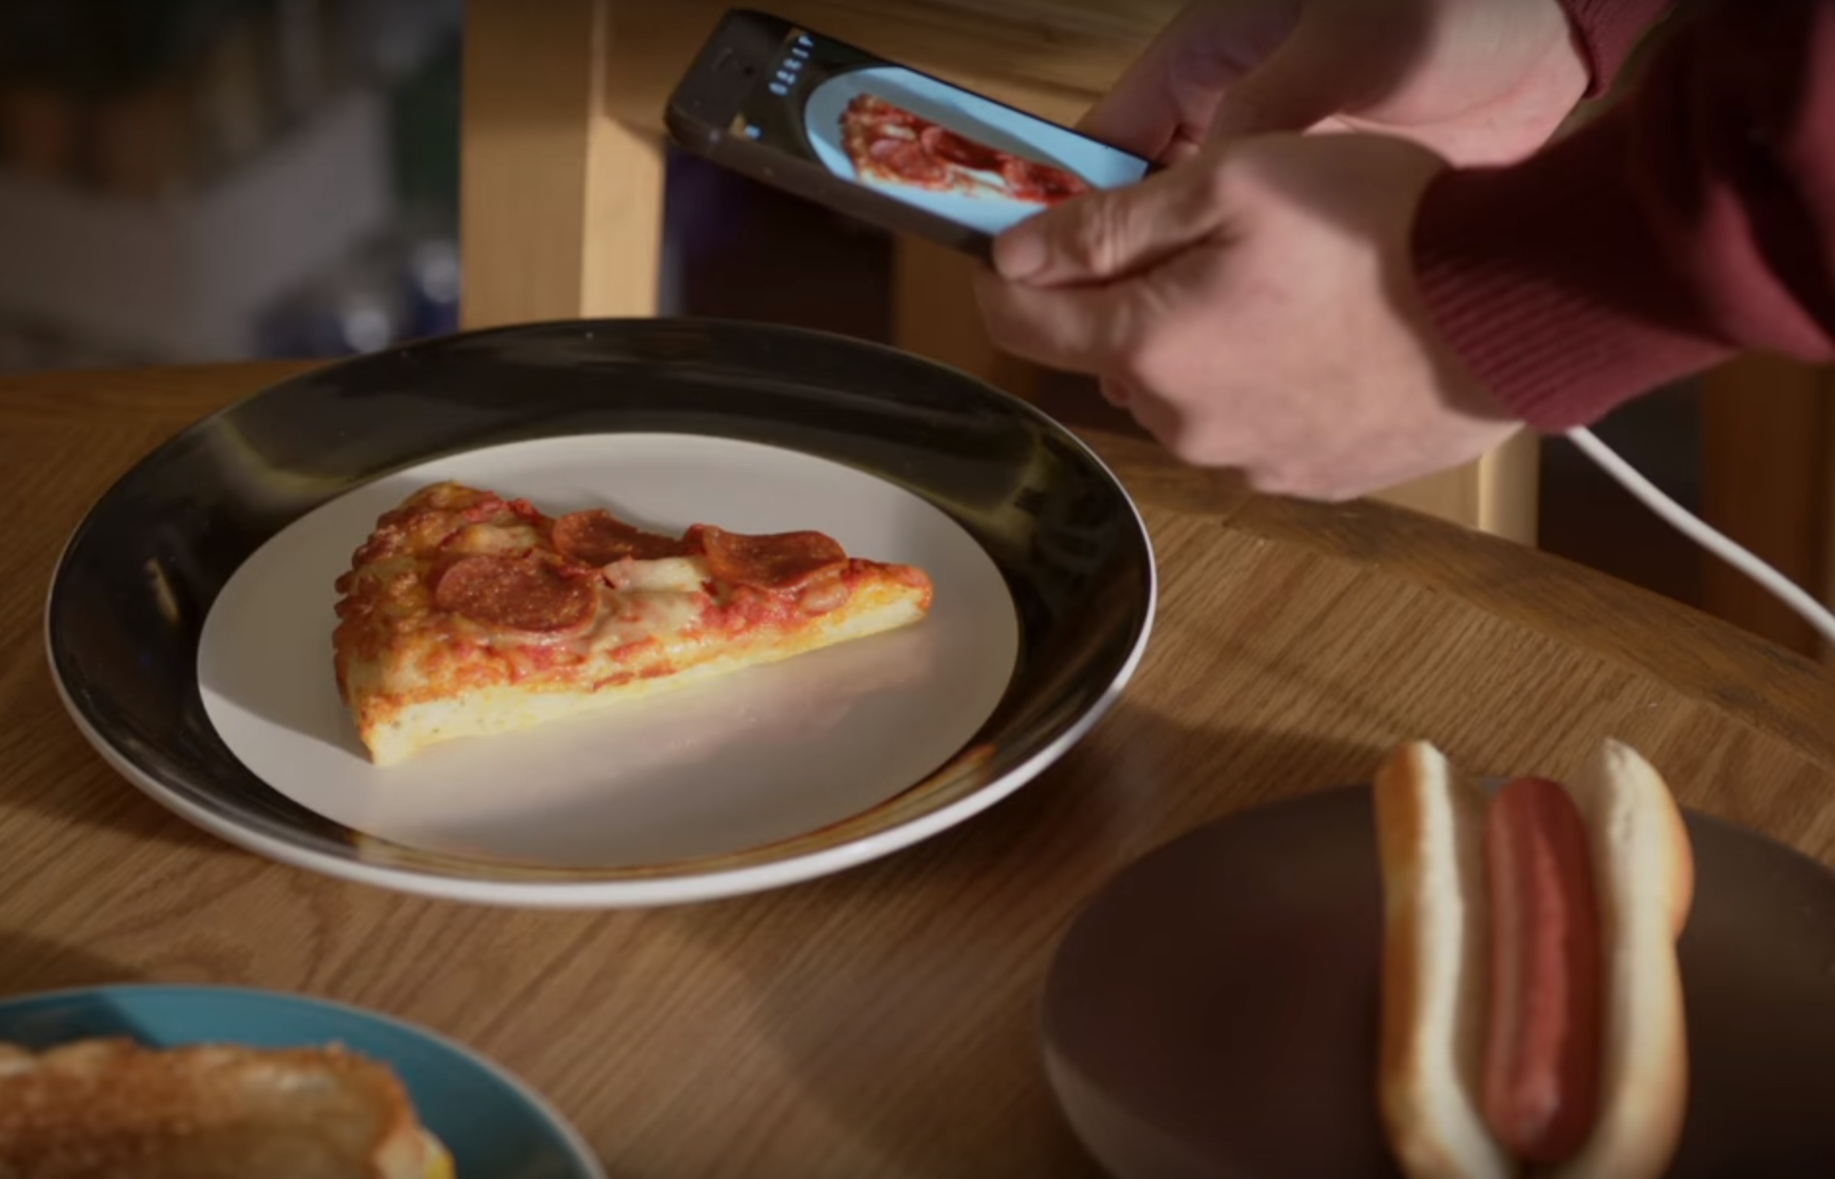
Stereotypical use case for image classification

Slide 5
Example use cases in hackathons
Boston #HackTrafficking4Good (Winter 2016)
Identify hotel chain where a human trafficking photograph was taken
Label images as explicit or not explicit
Kaggle competitions
Yelp: classify restaurants from user-submitted photos
Healthcare: diabetic retinopathy and cancer detection
Youtube: tag videos by category
NIPS 2017
Train an image classifier robust to spoofed images
Notes:
Common approach: don’t train your own neural network from scratch because it would take too long and cost too much; instead, retrain an existing one using transfer learning

Slide 6
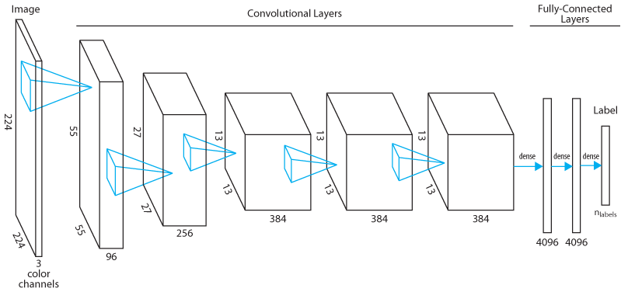
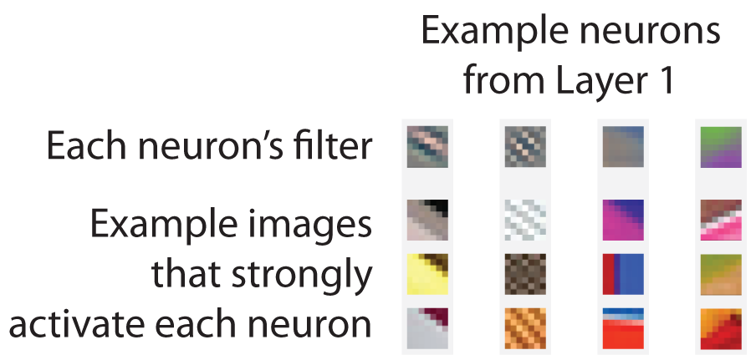
How trained image classifiers work (brief version)
Notes:
Like a human brain, mostly-sequential processing. The early layers often learn to perform directional edge detection.

Slide 7
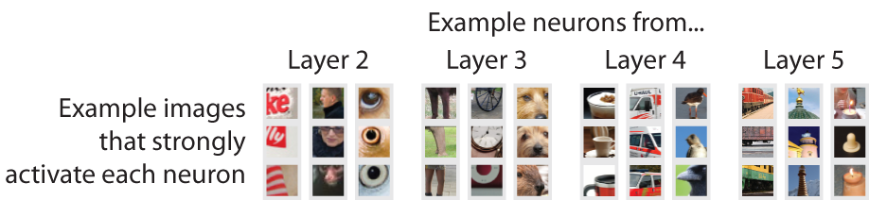
How trained image classifiers work (brief version)
Notes:
Simple patterns: color combinations, concentric circles
More complicated: legs, furry brown faces
Abstract: U-Haul represented from multiple angles, trains in all sorts of color schemes
Images courtesy of Matthew Zeiler

Slide 8
How to repurpose an existing image classifier
Replace last layer (because # of classes likely changes)
Keep early layers that detect edges, respond to simple patterns
Consider refining the last few layers (requires more training images)

Slide 9
How to repurpose an existing image classifier
Set up a GPU VM with the latest version of CNTK
Prepare labeled training and test image sets
Retrain the existing image classifier
Apply the retrained model to new images

Slide 10
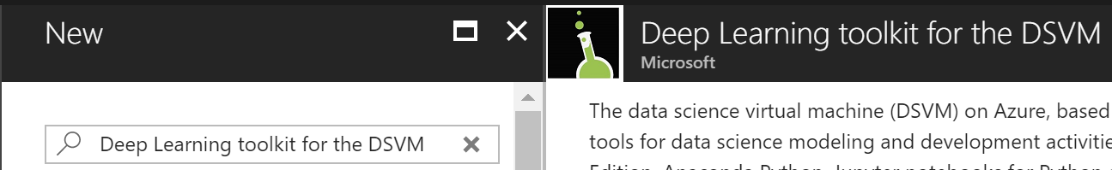
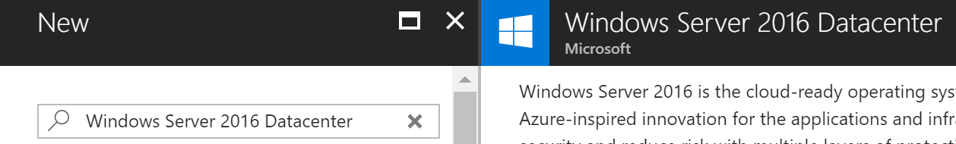
Set up a GPU VM with the latest version of CNTK
Notes:
Two types of resources that can be used for this. DSVM comes with CNTK/TF pre-installed, but unfortunately right now it’s an older version of CNTK (and the docs for the old version aren’t maintained).

Slide 11
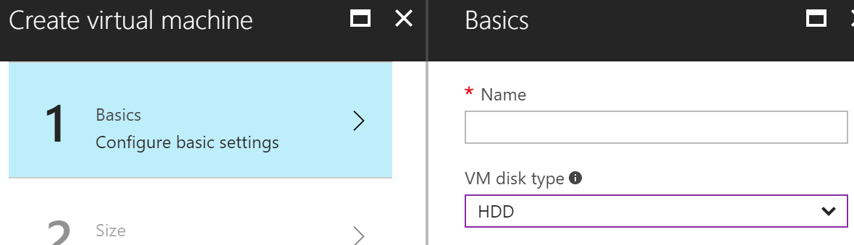
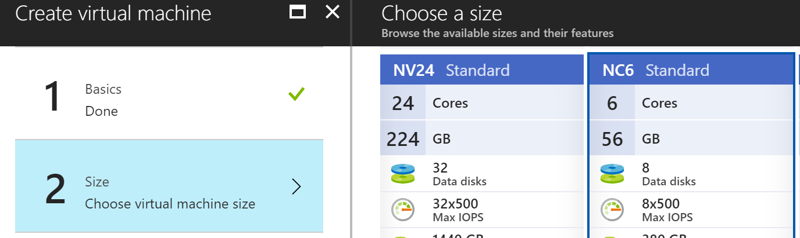
Set up a GPU VM with the latest version of CNTK
Don’t set the disk type to “SSD”, or you will not find the GPU VMs!
You probably want an “NC” series VM
Notes:
That is despite the NC series being advertised as having an SSD drive elsewhere.
NV series: NVIDIA Tesla K80
NC series: NVIDIA Tesla M60

Slide 12
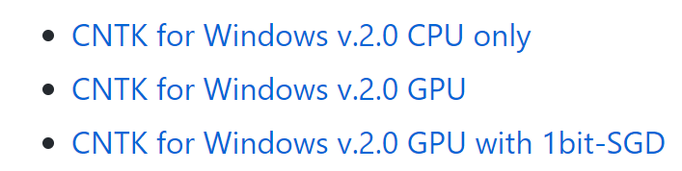
Set up a GPU VM with the latest version of CNTK
Use the binary installer (not the Python wheel!):
https://github.com/Microsoft/CNTK/releases
Point the installer to your VM’s Anaconda path:
https://docs.microsoft.com/en-us/cognitive-toolkit/setup-windows-binary-script-options
install.bat -AnacondaBasePath c:\Anaconda
-PyVersion 35
-Execute
-NoConfirm
A new Anaconda environment, cntk-py35, will be created
Notes:
Installing from a wheel sounds easy, but save yourself some hassle

Slide 13
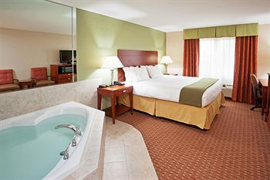
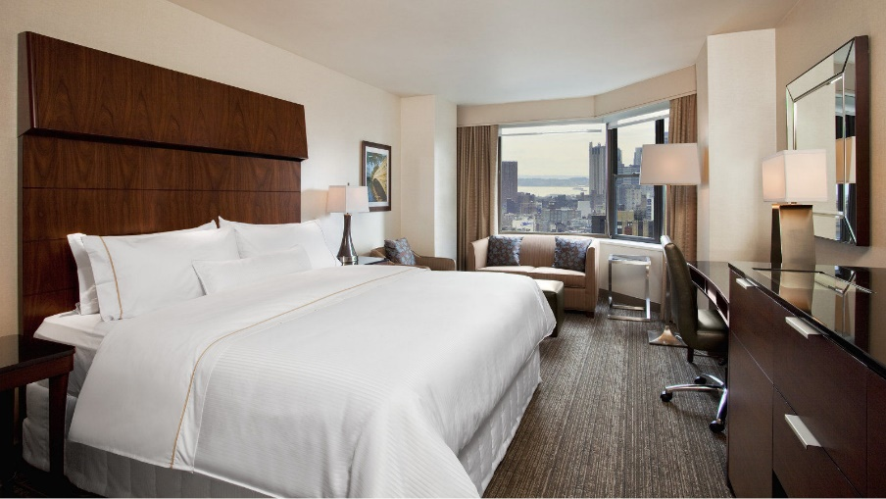
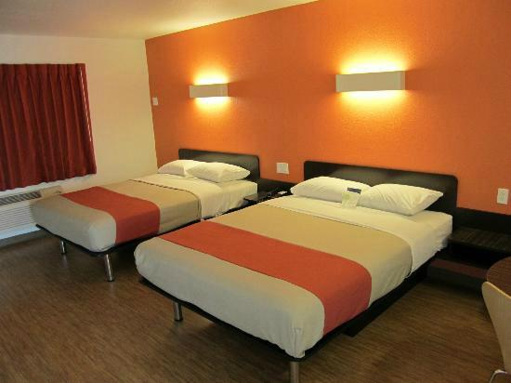
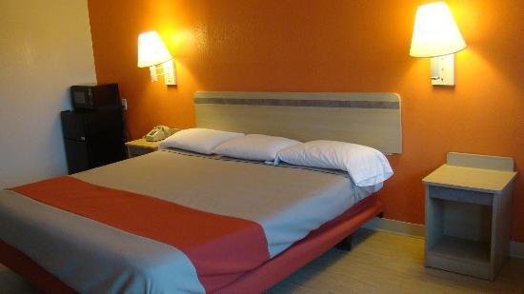

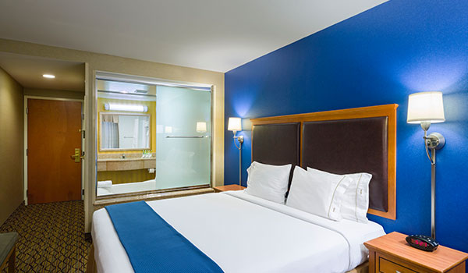
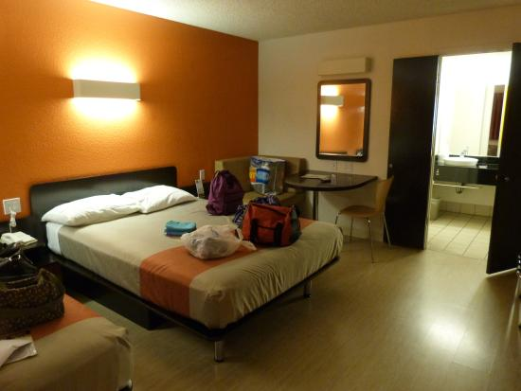
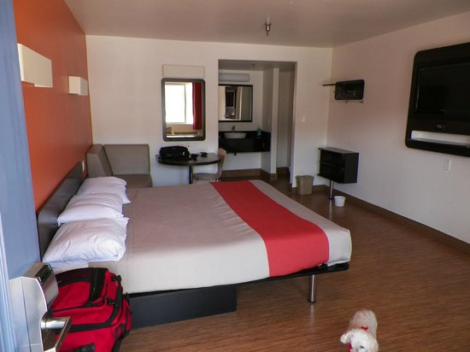
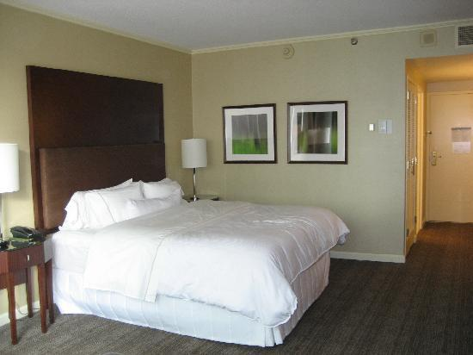
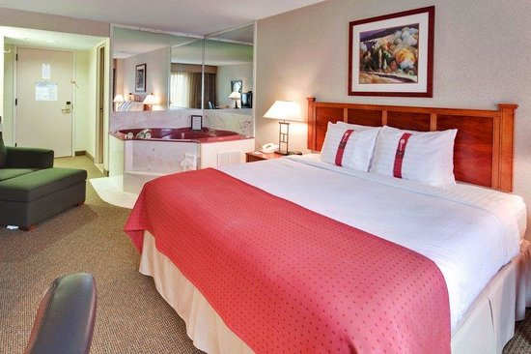
Prepare labeled training and test image sets
Supply examples of images in each class
Holiday Inn
Westin
Motel 6
(I provide an image search trawler script for this)
Notes:
Add even more “examples” by randomly perturbing the existing images (rotation, cropping, recoloring)
Discuss effects of class imbalance

Slide 14
Prepare labeled training and test image sets
Split images into training and test sets
Test set
Training set
The “test” images not used during training will help estimate the model’s future performance
Notes:
There are millions of parameters to be fitted in the neural network, so it’s easy to overfit and fool yourself into thinking you have a performant model. The test set helps you check what the model’s performance be like on images not used during training.

Slide 15
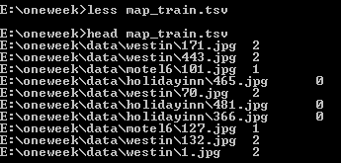
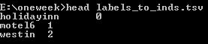
Prepare labeled training and test image sets
For CNTK: Create a MAP file listing each training image’s file path and label
CNTK uses this file type to coordinate parallel loading of input data in “minibatches” during training

Slide 16
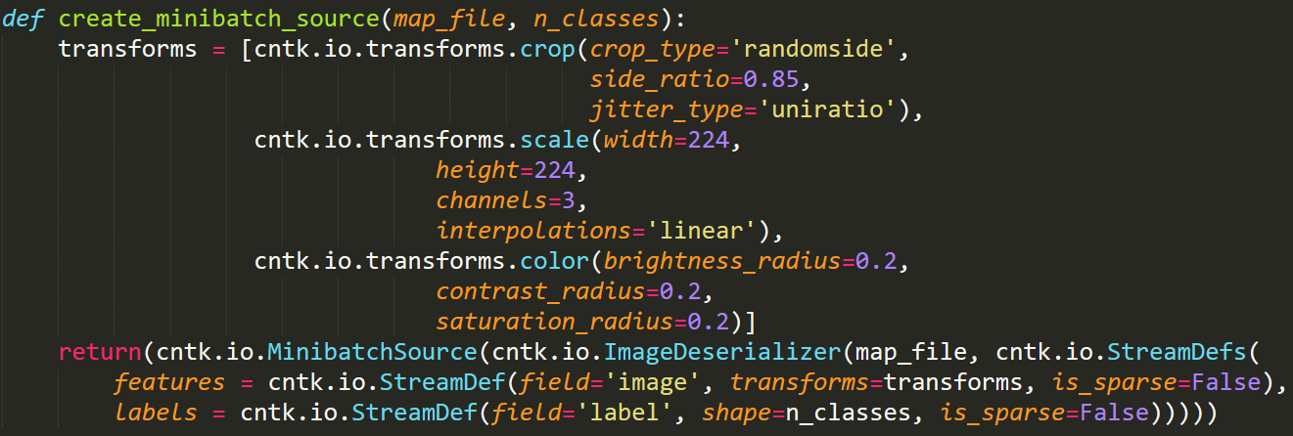
Retrain the existing image classifier
Define the “minibatch source” for training data
Notes:
A “minibatch” is a small number of images that get loaded from disk and used concurrently for training the model. (CNTK can process each image in parallel on the GPU, then combine the results to update the model just once for the whole minibatch.) Our minibatch source uses a built-in image deserializer that can interpret our MAP file to load the images.
But we don’t want to just load the images. We need to standardize their shape: squashing them to a width and height of 224, and RGB channels (e.g. converting grayscale images and dropping an alpha channel, if present). Furthermore, we randomly crop and recolor the images each time they’re read in, so that we effectively have a much bigger training set.

Slide 17
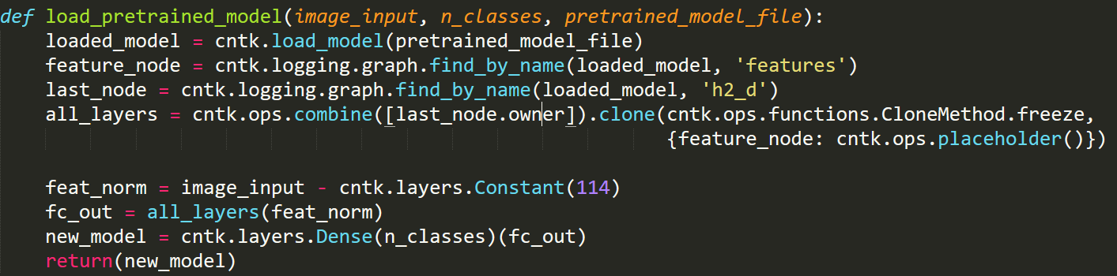
Retrain the existing image classifier
Load and slightly modify the pretrained image classifier

Slide 18
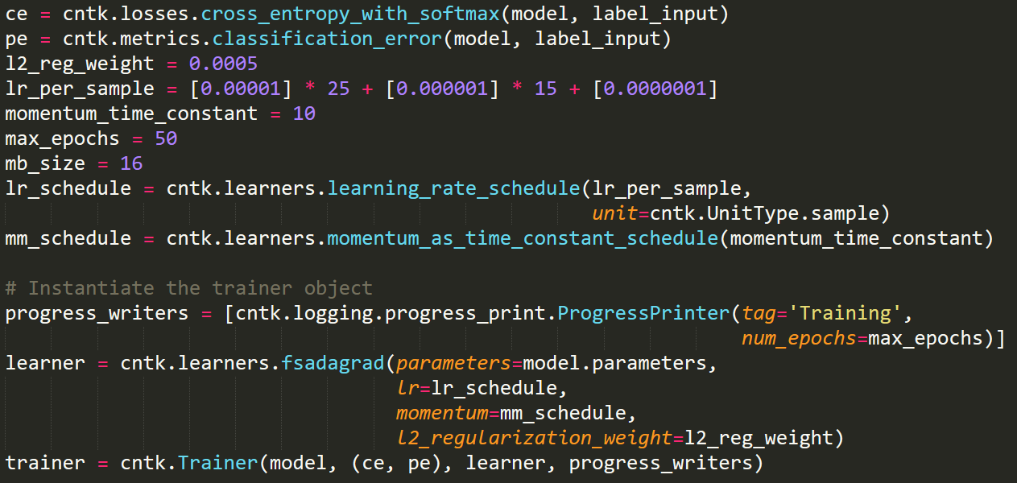
Retrain the existing image classifier
Define model training scheme, including hyperparameters

Slide 19
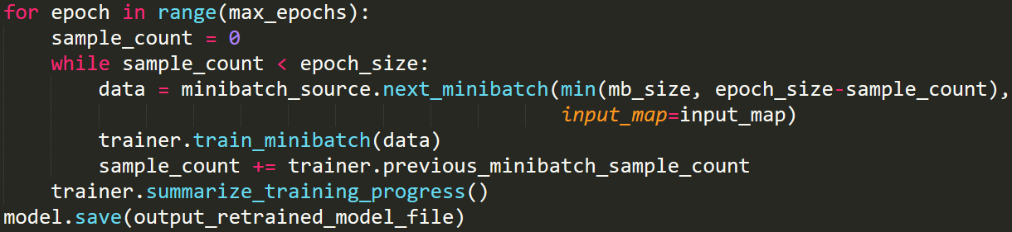
Retrain the existing image classifier
Retrain your model and save!

Slide 20
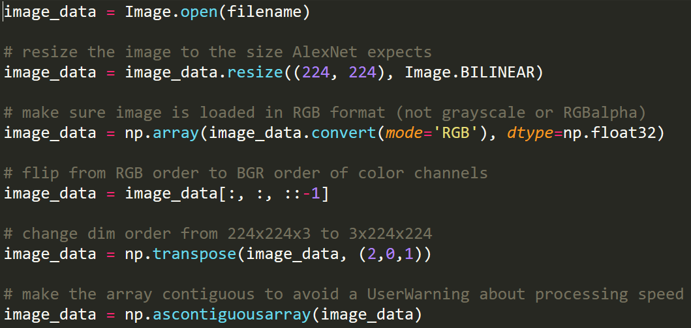
Apply the retrained model to new images
Watch out for “gotchas” when loading data without a minibatch source

Slide 21
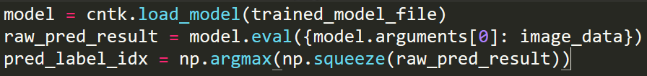
Apply the retrained model to new images
Evaluate the image and convert the results to a predicted label

Slide 22
NN that plays “Hangman”
User picks a secret word; states # of characters
NN tries to guess the letters of that word
The positions of all instances of a correctly-guessed letter are revealed in the word
Each incorrect guess adds a body part to the hangman
NN wins if it guesses all letters before the hangman is complete

Slide 23

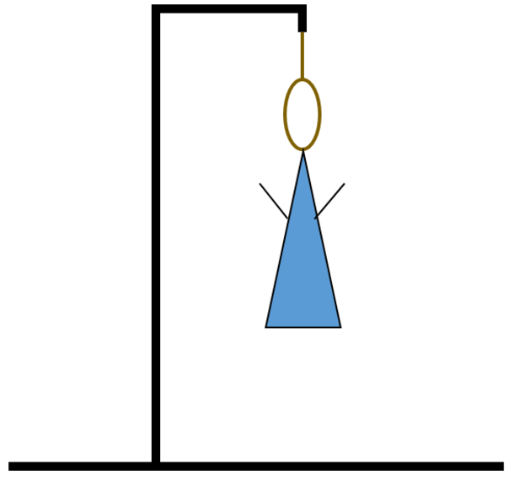
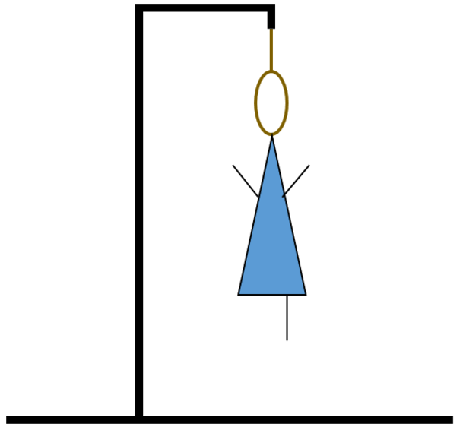
NN that plays “Hangman”
Partially-obscured word:
_ I _ R _ S _ _ _
Partially-obscured word:
_ I _ R _ S _ _ _
Letters already guessed:
A, E, I, L, R, S
Letters already guessed:
A, E, I, L, R, S, U
I guess the letter “U”

Slide 24
NN that plays “Hangman”
Partially-obscured word:
_ I _ R _ S _ _ _
Partially-obscured word:
_ I _ R _ S _ _ _
Letters already guessed:
A, E, I, L, R, S
Letters already guessed:
A, E, I, L, R, S, U
Hmm, that was really not a good guess!
“Reinforcement learning” trains a NN iteratively using feedback on past actions

Slide 25
How to build “Hangman”
Define the neural network model
Write a wrapper around the model to:
Update the “environment” after each guess
Provide feedback to the model for further training
Deploy the trained model in a Web App

Slide 26
Define the neural network model
Long Short Term Memory (LSTM) architecture:
Often used to convert variable-length sequences into a fixed-size output
Useful here because the hidden word’s length will vary
Often used with sequential input where order is relevant
Useful here because the order of blanks and letters in the word conveys important information

Slide 27
Define the neural network model
Partially-obscured word:
_ I _ R _ S _ _ _
Represent as length-nine sequence of one-hot 1x27 vectors:
(0, 26): 1
(1, 8): 1
(2, 26): 1
(3, 17): 1
etc.
Feed into LSTM and retain the LSTM’s final output vector
[0, 0.57, 0.21, 0, 1.2, …]
Letters already guessed:
A, E, I, L, R, S
Represent as binary 1x26 vector:
[1, 0, 0, 0, 1, 0, …]
Concatenate these inputs together to make a single input for a dense neural network (with 26 nodes in its final layer)

Slide 28
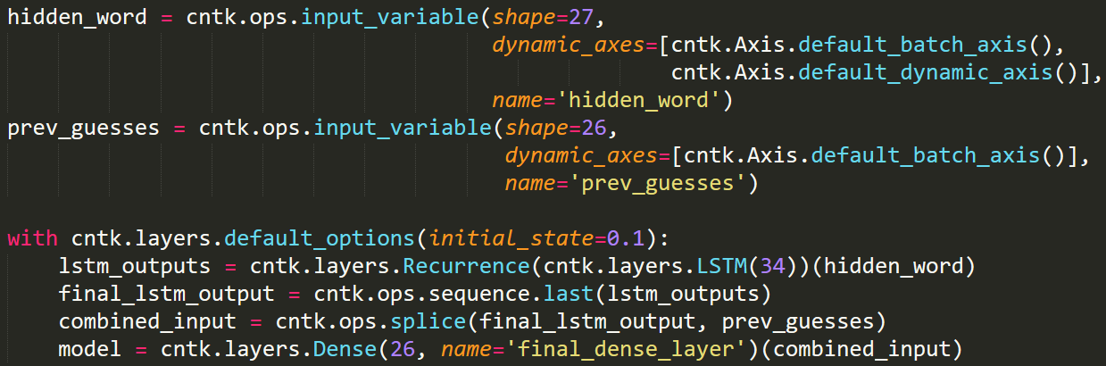
Define the neural network model
Notes:
Describe the dynamic axis types

Slide 29
Write a wrapper around the model to orchestrate reinforcement learning
Highly application-specific, in this case:
Coordinates gameplay by choosing and remembering a hidden word
Keeps track of the letters guessed so far, current word appearance, and number of lives used
Properly formats input to be fed into the model
Stores each guess and feedback on its quality
After each game, retrains the model using the feedback from all rounds of that game

Slide 30
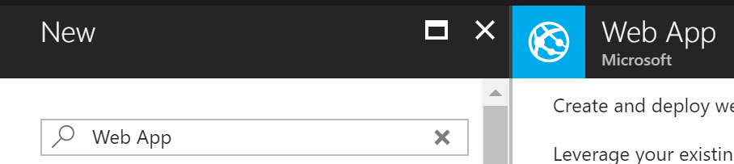
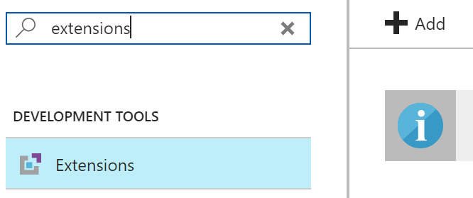
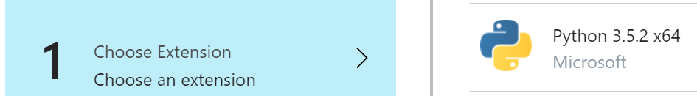
Deploy the trained model in a Web App
Create a Web App running 64-bit Python 3.5

Slide 31
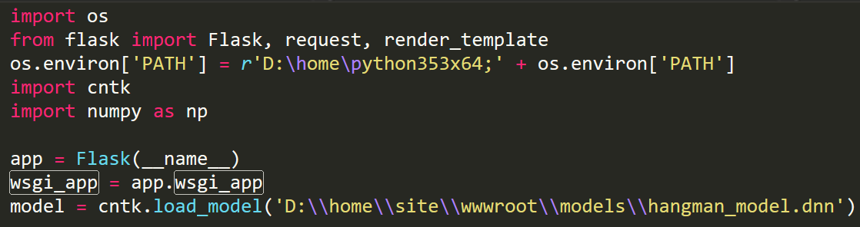
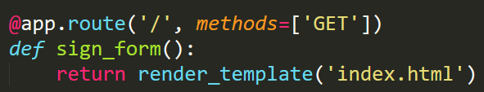
Deploy the trained model in a Web App
Write a Flask app to load and run your model
Notes:
Note the issue with importing CNTK and the fact that we actually had to bundle up the DLLs from another installation and upload them here.
Also note that the model is being loaded once at the beginning. For a ~200 MB model like most image classification DNNs, this is really necessary to reduce subsequent load latency.
Web server gateway interface

Slide 32
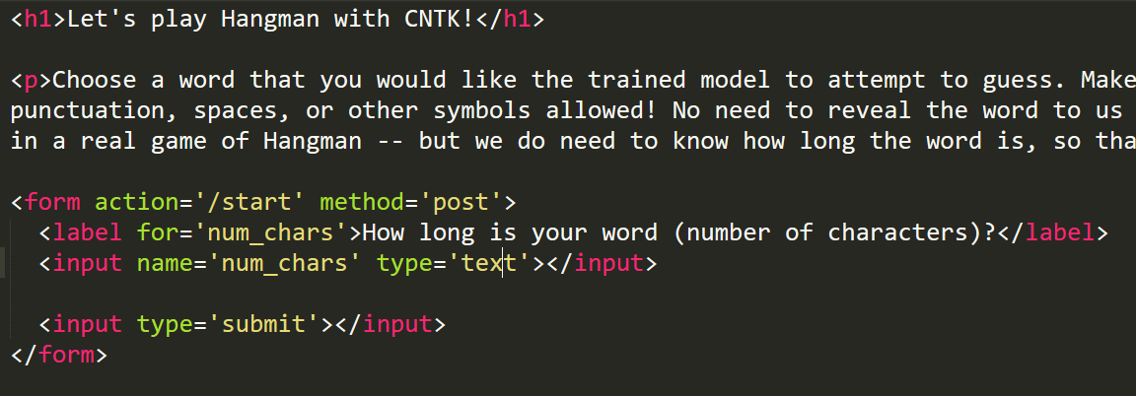
Deploy the trained model in a Web App
Write a Flask app to load and run your model
Notes:
Note the issue with importing CNTK and the fact that we actually had to bundle up the DLLs from another installation and upload them here.
Also note that the model is being loaded once at the beginning. For a ~200 MB model like most image classification DNNs, this is really necessary to reduce subsequent load latency.
Web server gateway interface

Slide 33
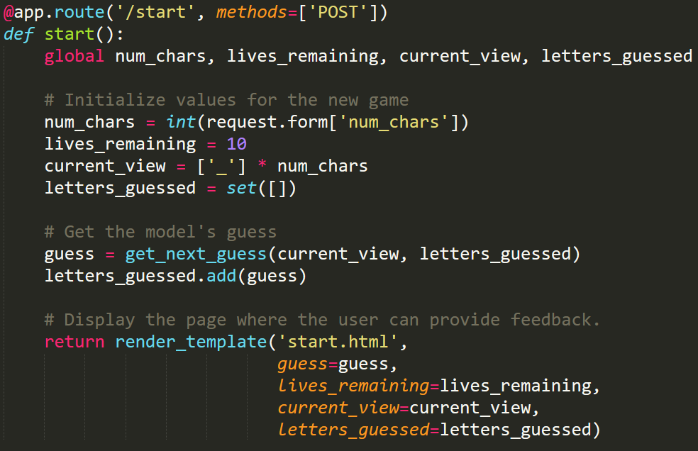
Deploy the trained model in a Web App
Write a Flask app to load and run your model
Notes:
Note the issue with importing CNTK and the fact that we actually had to bundle up the DLLs from another installation and upload them here.
Also note that the model is being loaded once at the beginning. For a ~200 MB model like most image classification DNNs, this is really necessary to reduce subsequent load latency.
Web server gateway interface

Slide 34
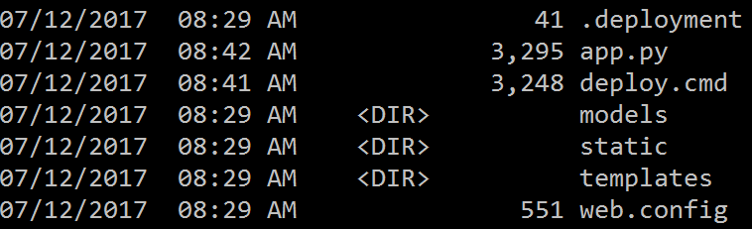
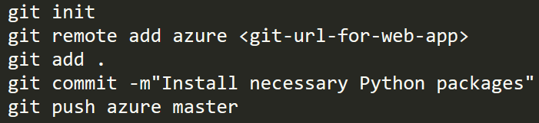
How to embed your classifier in an Azure Web App
Upload files and install CNTK using local Git deployment
.deployment and deploy.cmd:
defaults available from the Web App’s Kudu Console
Modify deploy.cmd to install numpy, scipy, and cntk (with math libraries) from Python wheels
web.config:
Defines environment variables and the Python/FastCGI paths

Slide 35
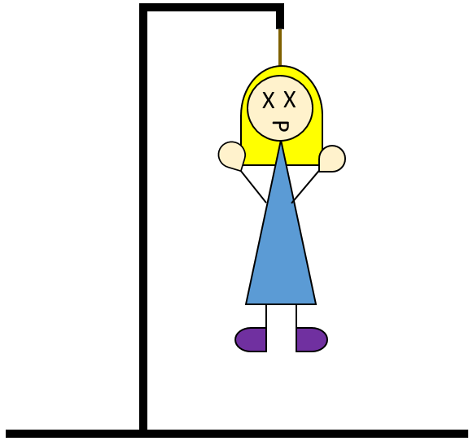
How to embed your classifier in an Azure Web App
Demo:
http://mewhangman.azurewebsites.net/
Notes:
Consider setting up a WebJob to ping the site frequently, keeping it warm

Slide 36
References
CNTK in general
Releases (see also script install instructions incl. optional arguments)
Python API reference docs
Tutorials (include explanations) and Examples folders
edX course (lecture videos, homework assignments)
Neural networks in general
Brandon Rohrer’s intro to CNNs and intro to LSTM videos
An introduction to transfer learning for image classification
An introduction to LSTMs and other RNNs

Slide 37
More references
More examples of transfer learning for image classification with CNTK:
Patrick Buehler’s grocery example including object detection
My aerial image example showing operationalization on Spark
Miguel Fierro’s cancer detection Kaggle competition quick-start guide
Alternative approaches:
Train your CNTK model at scale using Azure Batch Shipyard
Train and create scoring API using Custom Vision Service
The original CNTK on Web Apps example from Ilia Karmanov
Examples covered in this talk:
https://github.com/mawah/oneweektutorial2017
https://github.com/Azure/Hangman

